Slide 1
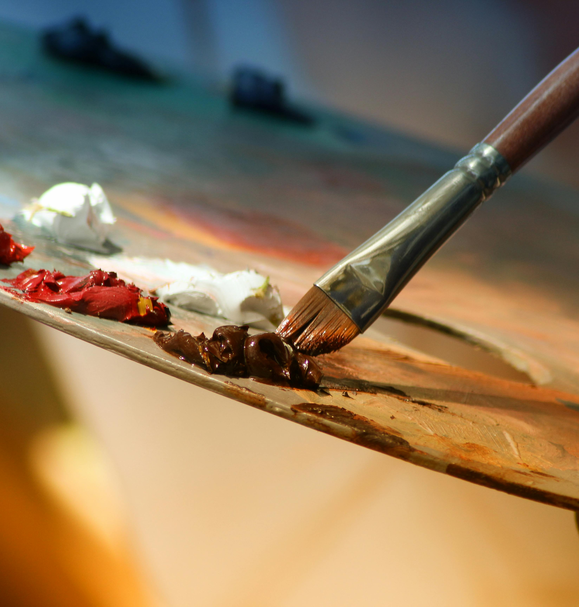
Drawing
Maryam Ali

Slide 2
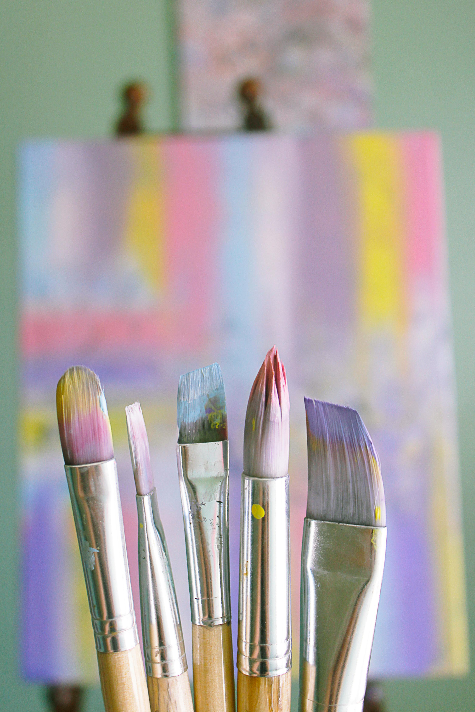
AGENDA
Introduction
The History of Drawing
Engaging the audience
Visual aids
Final tips & takeaways

Slide 3
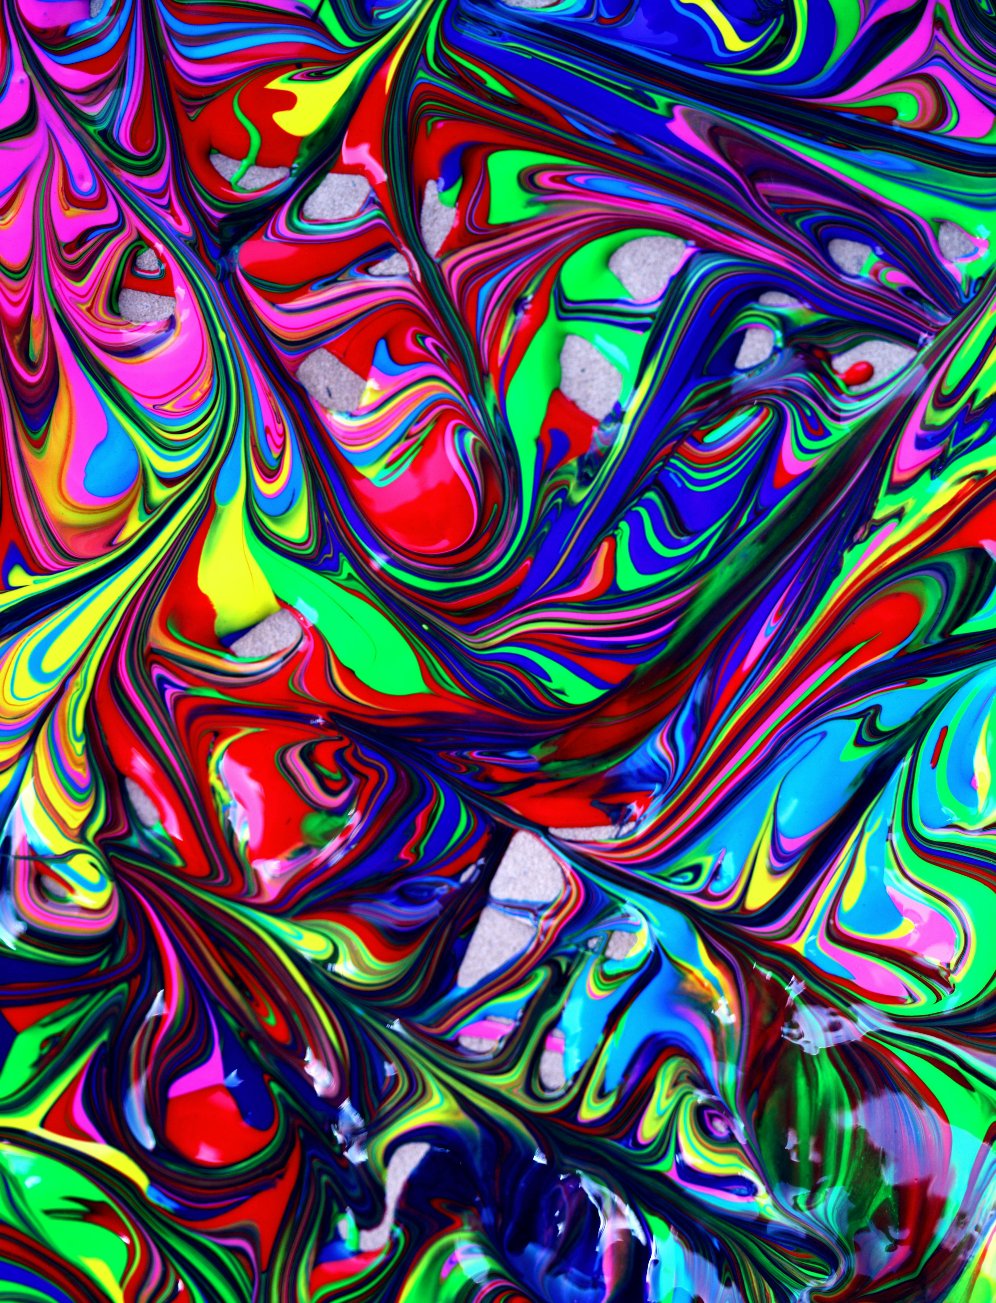
Introduction
Drawing: the art or technique of producing images on a surface, usually paper, by means of marks, usually of ink, graphite, chalk, charcoal, or crayon.
Drawing as formal artistic creation might be defined as: the primarily linear rendition of objects in the visible world, as well as of concepts, thoughts, attitudes, emotions, and fantasies given visual form, of symbols and even of abstract forms.
in the next pages we will learn more about drawing like Types, tools and the benefits of Drawing

Slide 4
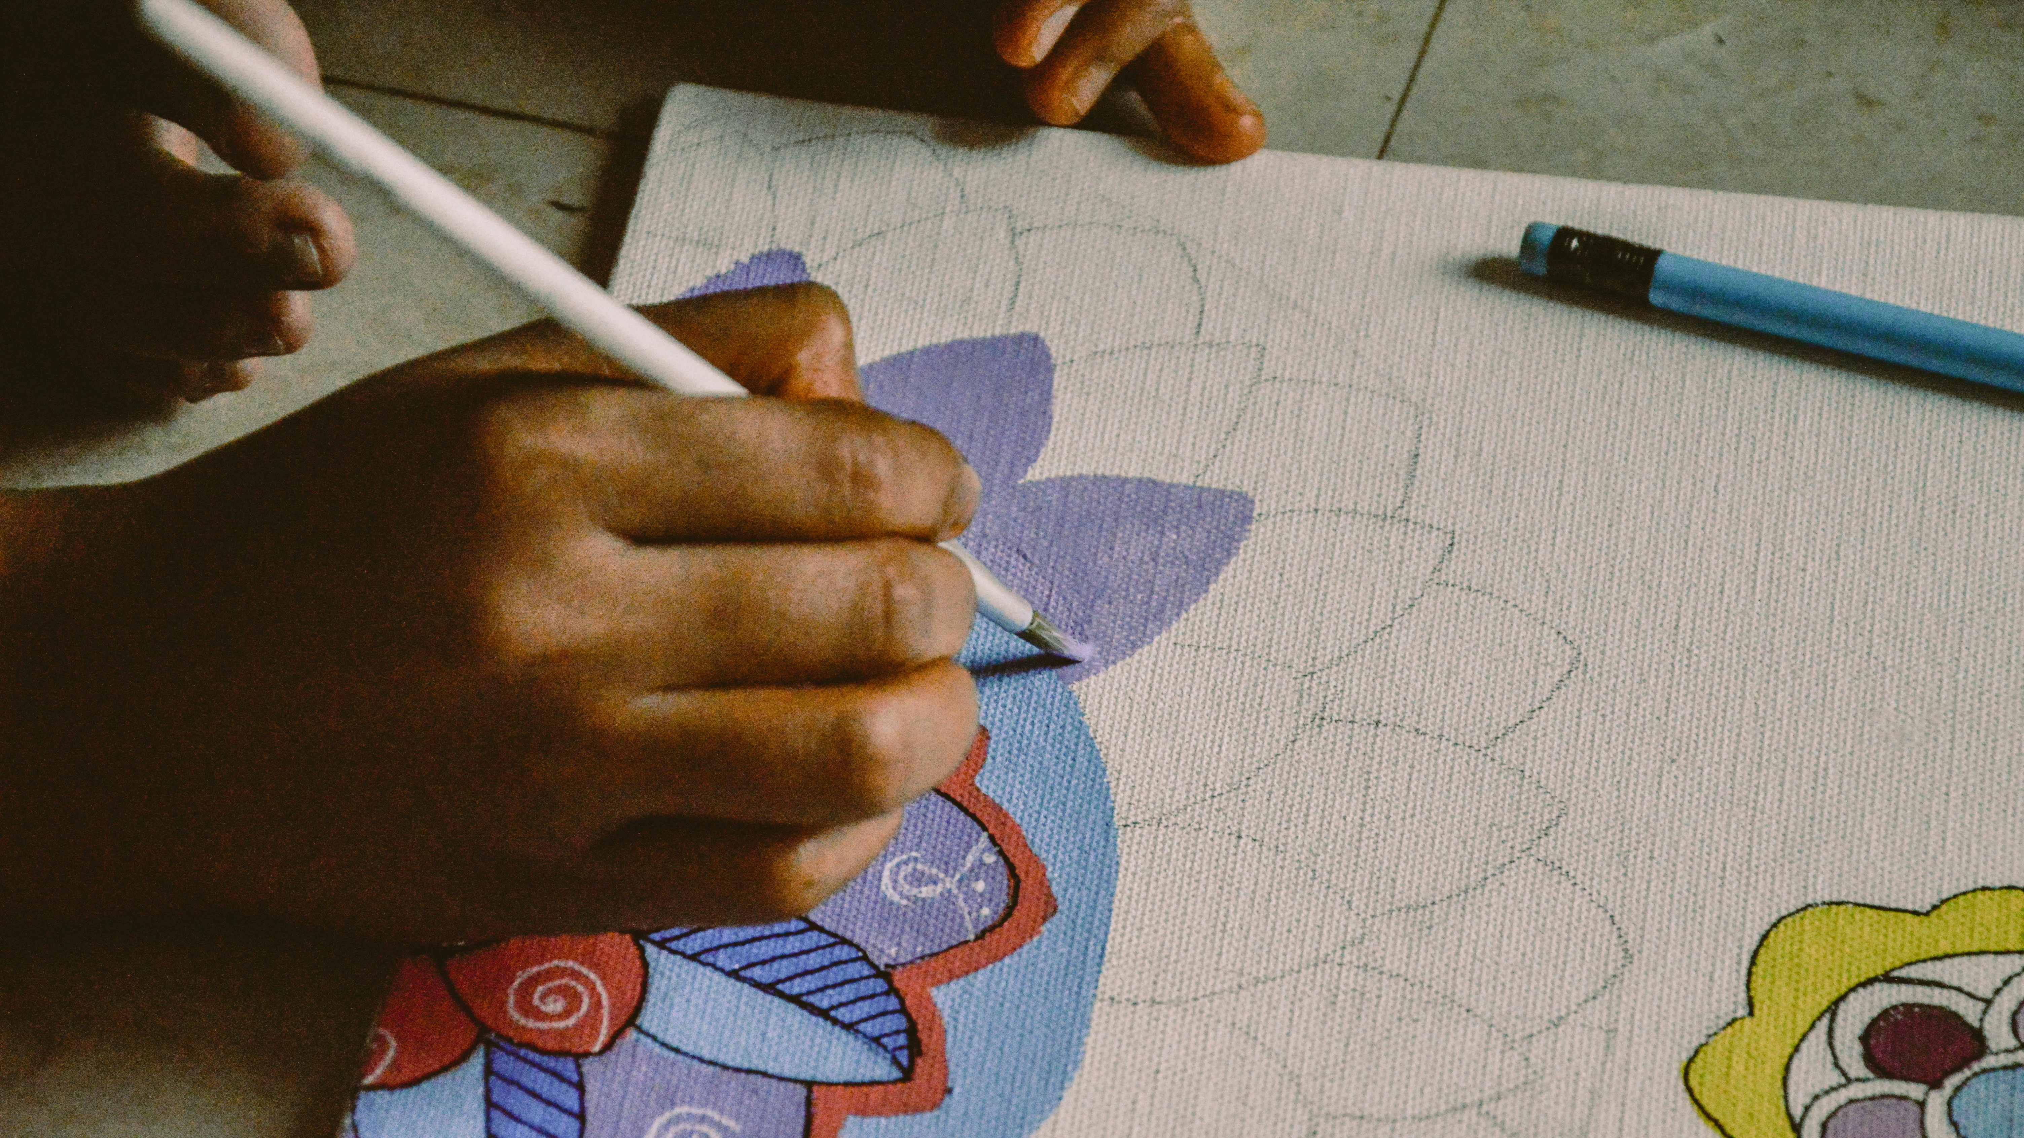
Types of drawing

Slide 5
Sketch
You can usually tell a sketch drawing by its less-refined lines and edges and unpolished look. Artists often create sketches with simple, quick marks and may ignore adding certain details that aren't important to the piece. They are typically used to show a working concept or capture something important in a short amount of time.
Perspective drawing
Artists use perspective drawing, also known as 3D or anamorphic drawing, to create three-dimensional images in a two-dimensional space, such as on paper. Those who use this type of drawing pay attention to distance, space, light, volume, surface and scale to determine how each object relates to one another.
Line Drawing
Line drawing focuses on the use of straight lines and contours without shading. In most line drawings, the artist creates an entire image without picking their instrument up from the surface. Line drawing may teach the importance of angles and curves without putting an emphasis on detail.

Slide 6

Drawing Tools

Slide 7
Some of drawing tools
Chalk: is a powdery drawing tool made from naturally occurring minerals. Often, manufacturers add other pigments to create colors besides red, white and black. Chalk is a suitable tool for blending and shading and works on many surfaces. It's easily transferable among surfaces.
Charcoal: is a crumbly black material made of carbon. In art, it's often sold in sticks or pencils. It's an excellent tool for shading and blending because it's easily smudged.
Colored pencils: are wood shells with wax or oil pigmented centers. They come in a variety of colors and hues. Unlike other materials, they're less like to smudge but still blend easily.
Wax crayons: add color to drawings in a non-transferable way. Because of their construction, crayons are less likely to transfer surfaces, but are also more difficult to use for blending and shading.

Slide 8

Benefits of drawing

Slide 9
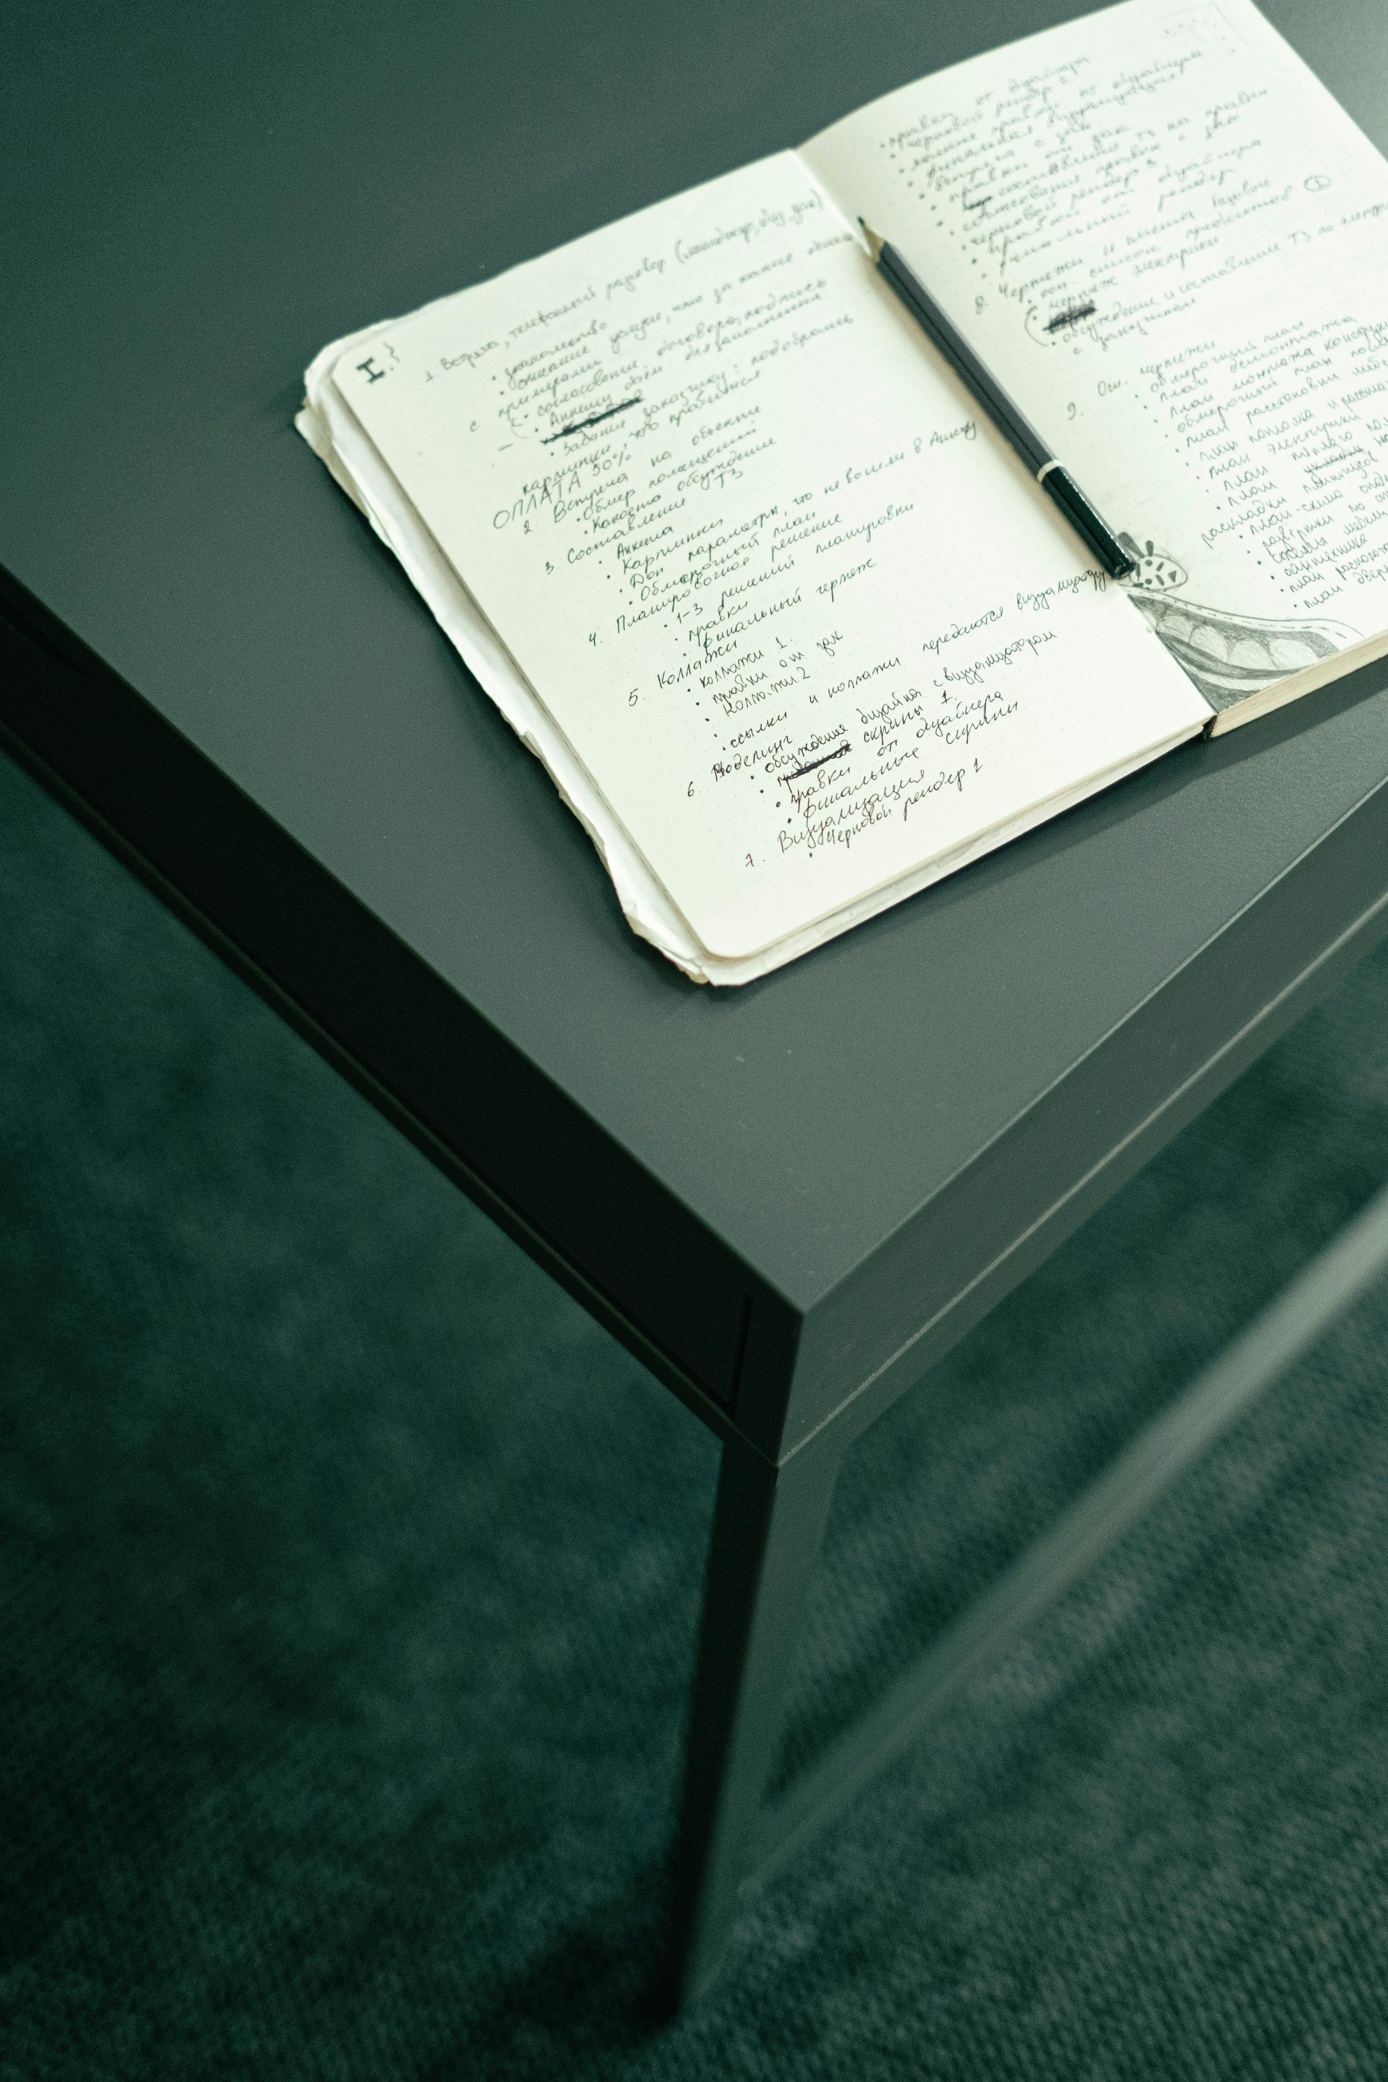
Some Benefits of drawing
a) Enhance your communication skills
b) Boost your creativity
c) Optimize your memory function
d) Enhance your emotional intelligence
e) Enhances problem-solving abilities
f) Enhances focus

Slide 10
AGENDA
indeed
britannica
theknowledgeacademy

Slide 11

THANK YOU

